Slide 1
Lecture 03
Cryptographic Hash Functions

Slide 2
Do not distribute ...
These slides are not always prepared by me.
Most of the content comes from the reference book
  Bitcoin and Cryptocurrency Technologies: A Comprehensive Introduction
  Arvind Narayanan, Joseph Bonneau,
  Edward Felten, Andrew Miller, Steven Goldfeder

Slide 3
Review
What is the difference between Bitcoin and Blockchain?
What is a distributed ledger, consensus and mining?
Do different miners solve the same puzzle i.e. they work on the same input?
Bitcoins are in limited supply? What would be the incentive for miners when they run out?

Slide 4
Cryptographic Hash Functions
Notes:
This is going to be kinda mathy. Sorry about that. I’ll do my best to tell you just what you need to know, and approach things intuitively. Those who want all of the formal mathy details will have to do some more reading.

Slide 5
Cryptographic Hash Functions
Hash function:
  takes any string as input
  fixed-size output (we’ll use 256 bits)
  efficiently computable
Security properties:
  collision-free
  hiding
  puzzle-friendly

Slide 6
Hash property 1: Collision-free
Nobody can find x and y such that
x != y and H(x)=H(y)
x
H(x) = H(y)
y

Slide 7
Collisions do exist ...
possible outputs
possible inputs
… but can anyone find them?

Slide 8
How to find a collision
try 2¹³⁰ randomly chosen inputs
99.8% chance that two of them will collide
if a computer calculates 10,000 hashes per second, it would take more than one octillion (10 ²⁷ ​) years to calculate 2​¹²⁸ ​hashes!
This works no matter what H is …
… but it takes too long to matter
Notes:
For another way of thinking about this, we can say that, if every computer ever made by humanity was computing since the beginning of the entire universe, up to now, the odds that they would have found a collision is still infinitesimally small. So small that it’s way less than the odds that the Earth will be destroyed by a giant meteor in the next two seconds.

Slide 9
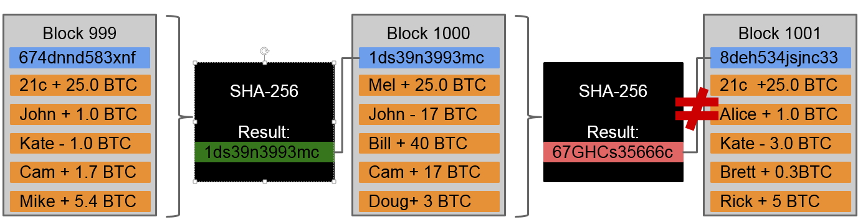
Bitcoin Blockchain
Even making that small change results in a very different block hash. It no longer matches what is stored in block 1001

Slide 10
Is there a faster way to find collisions?
For some possible H’s, yes.
For others, we don’t know of one.
No H has been proven collision-free.

Slide 11


Application: Hash as message digest
If we know H(x) = H(y),
it’s safe to assume that x = y.
Suppose that Bob uploads really large file and wants to be able to verify later that the file he downloads is the same as the one he uploaded.
Compare (hash created at time of upload, hash obtained after the download) (fix length)
upload
download
Notes:
PGP

Slide 12

Application: InterPlanetary File System (IPFS)
Today's web is inefficient and expensive
Today's web uses location based addressing – this leads to redundancy

Slide 13
The centralized web: Location-based addressing
URLs are based on the location where data is stored,
Through the domain name, URLs indicate which authority we should go to for the data.
This also results in lot of redundancy

Slide 14
The decentralized web: Content addressing
On the decentralized web, we can host each other's data
Cryptographic hashing enables content addressing
Hashes can be derived from the content of the data itself, if hashes are same so is the content
When we want a specific photo of an adorable pet, we ask for it by its content address (hash).
Who do we ask? The whole network!

Slide 15
Hash property 2: Hiding
The hiding property asserts that if we’re given the output of the hash function ​ y ​ = ​ H(x)​ , there’s no feasible way to figure out what the input, ​ x​ , was.
We want something like this:
Given H(x), it is infeasible to find x.
x= apple
H(x)= 3a7bd3e2360a3d29eea436fcfb7e44c735d117c42d1c1835420b6b9942dd4f1b

Slide 16

Hash property 2: Hiding
This will not work when ​x​ has to be chosen from a set that’s, in some sense, NOT spread out. For example, flip a coin gives two possible values: head or tail.
In response, compute both the hash of the string “heads” and the hash of the string “tails”, and they could see which one they were given as an input
H(“heads”)
easy to find x!
H(“tails”)

Slide 17
Hash property 2: Hiding
Can we achieve the hiding property when the values that we want do not come from a spread‐out set?
Answer is YES
we can hide an input that’s not spread out by concatenating it with another input that ​ is spread out.
H(r | x) (the vertical bar | denotes concatenation)

Slide 18
Hash property 2: Hiding
So, for a concrete example, if ​ r ​is chosen uniformly from among all of the strings that are 256 bits long, then any particular string was chosen with probability 1/2​²⁵⁶, which is an infinitesimally small value

Slide 19
Hash property 2: Hiding
If r is chosen from a probability distribution that has high min-entropy, then given H(r | x), it is infeasible to find x.
min‐entropy​​ is a measure of how predictable an outcome is, and high min‐entropy captures the intuitive idea that the distribution (i.e., random variable) is very spread out.

Slide 20
Hash property : Hiding use case
Common use of hiding property of hash is to secure passwords
Instead of storing the password in the system, a more secure approach is just storing the hash of the password and compare the hash to verify the user.
this way, the user password won’t be at risk even the system is broken by attackers
Problem!
many people tend to use simple words as their passwords
Compare the hash password with a of commonly used passwords (hashed)

Slide 21
Hash property : Hiding use case
Solution!
Use a randomly generated ‘salt’ to safeguard the password.
hash(password|salt)=output
By appending a salt to the password, attackers can no longer use a pre-calculated password-hash map to attack the system. Even two users happened to choose the same string as their passwords, the hashes stored in the system are different because their salts are different, which is randomly generated.
Notes:
To solve this problem, we can append a generated random value to the password, this value is often called ‘salt’. Salt is saved along with the hashed password in the system. So the system can get the hash out of the combination of user password and salt, compare it with the stored hash to verify user identity.
By appending a salt to the password, attackers can no longer use a pre-calculated password-hash map to attack the system. Even two users happened to choose the same string as their passwords, the hashes stored in the system are different because their salts are different, which is randomly generated.
As the table above illustrates, different salt values will create completely different hashed values, even when the plaintext passwords are exactly the same. Additionally, dictionary attacks are mitigated to a degree as an attacker cannot practically precompute the hashes. However, a salt cannot protect against common or easily guessed passwords because the attacker can still combine the salt with all the possible password in the dictionary and try to match the hash of the combinations with the hashed value stored in the attached target. The salt just makes the attack more difficult because attackers need two additional steps: 1. find out the salt of the attacked target 2. Calculate the hash every time

Slide 22
Application: Commitment
Want to “seal a value in an envelope”, and
“open the envelope” later.
Commit to a value, reveal it later.

Slide 23
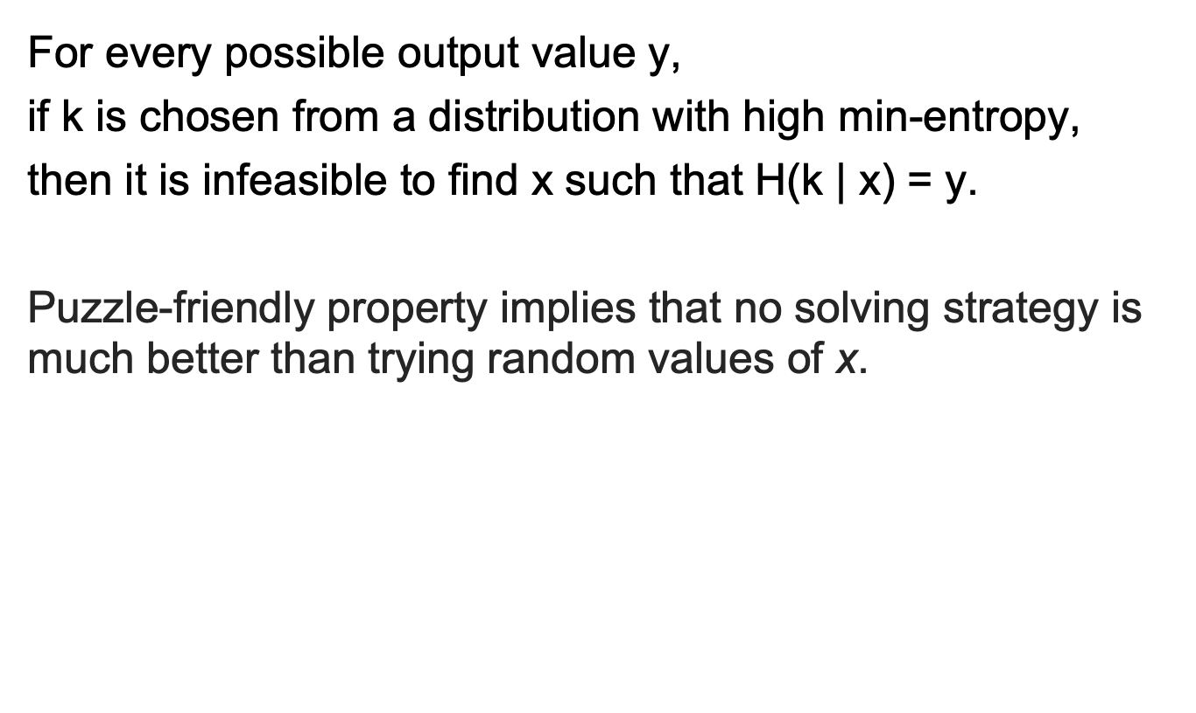
Hash property 3: Puzzle-friendly

Slide 24
Hash-Functions
Some of the most commonly used:
  Secure Hashing Algorithm (SHA-2 and SHA-3)
  Message Digest Algorithm 5 (MD5)
  Keccak – used by Ethereum
SHA-2 is a family of hash functions that includes SHA-224, SHA-256, SHA-384, SHA-512, …

Slide 25
Problem?
SHA-256 works on fixed length input 768bits
However, we require that our hash functions work on inputs of arbitrary length
Solution
As long as we can build a hash function that works on fixed‐length inputs, there’s a generic method to convert it into a hash function that works on arbitrary‐length inputs called the M​erkle‐Damgard transform.​

Slide 26
SHA-256 - Merkle‐Damgard transform
Padding
512 bits
Message
(block 1)
Message
(block 2)
Message
(block n)
256 bits
256 bits
c
c
c
IV
Hash
Theorem: If c is collision-free, then SHA-256 is collision-free.
Notes:
SHA‐256 uses a compression function that takes 768‐bit input and produces 256‐bit outputs. The block size is 512 bits. See Figure 1.3 for a graphical depiction of how SHA‐256 works.

Slide 27
Do not distribute ...
These slides are not always prepared by me.
Most of the content comes from the reference book
  Bitcoin and Cryptocurrency Technologies: A Comprehensive Introduction
  Arvind Narayanan, Joseph Bonneau,
  Edward Felten, Andrew Miller, Steven Goldfeder

